Slide 1


traffictelligence: Advanced Traffic Volume Estimation with Machine Learning
Discover how cutting-edge machine learning revolutionises traffic volume estimation, offering unparalleled accuracy and actionable insights for smarter urban mobility.
by Gmailmcom

Slide 2
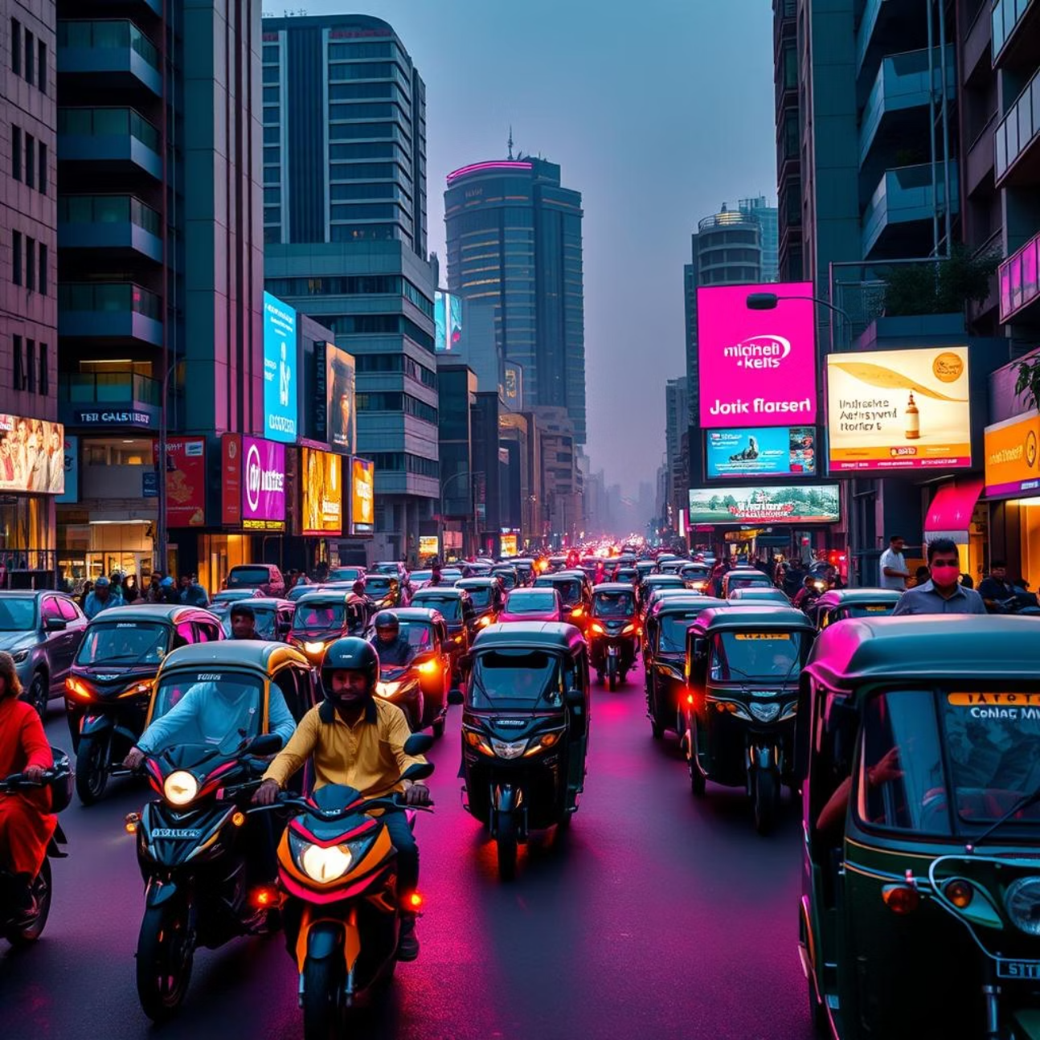
The Urban Pulse: Why Accurate Traffic Data is Crucial for India
India's rapid urbanisation brings immense pressure on its infrastructure. Accurate traffic data is vital for mitigating congestion, optimising public transport, and enhancing road safety. Understanding the ebb and flow of vehicles is no longer a luxury, but a necessity for sustainable city planning and a thriving economy.
Congestion Mitigation: Reduce travel times and fuel consumption.
Infrastructure Planning: Design better roads and public transport routes.
Economic Efficiency: Boost productivity by reducing delays.
Environmental Impact: Lower emissions from idling vehicles.

Slide 3





Current Roadblocks: Limitations of Traditional Traffic Measurement Methods
Manual Counting
Labour-intensive, prone to human error, and not scalable for large areas or continuous monitoring. Data collection is sporadic and often lacks real-time insights.
Loop Detectors
Expensive to install and maintain, susceptible to damage, and provide limited data points (e.g., presence, speed) rather than comprehensive volume. Requires road disruption for installation.
Pneumatic Tubes
Temporary solutions, easily damaged, and less accurate in high-density traffic. Their deployment is inconvenient and often requires frequent calibration.
GPS Tracking
Relies on individual device usage, which isn't always representative of overall traffic. Privacy concerns and data availability can be significant limitations.
Traditional methods often fall short in providing the granularity, real-time insights, and scalability needed for modern urban challenges. They offer a snapshot, not a continuous, predictive view.

Slide 4

Introducing traffictelligence: Our Machine Learning-Powered Solution
traffictelligence leverages state-of-the-art machine learning algorithms to overcome the limitations of conventional traffic monitoring. By processing diverse data inputs, we provide highly accurate and real-time traffic volume estimations. Our solution offers predictive capabilities, enabling proactive decision-making for urban planners and logistics companies.
Accuracy: Superior precision in traffic volume estimation.
Real-time Insights: Instant access to current traffic conditions.
Predictive Power: Forecast future traffic patterns.
Scalability: Adaptable to any urban scale or network size.

Slide 5








Data Alchemy: Sources and Pre-processing for Intelligent Insights
Vehicle Sensors
CCTV Feeds
Anonymised data from in-car sensors and aggregated GPS logs provide movement patterns.
Analysed for vehicle detection and counting using advanced computer vision.
Historical Data
Weather Data
Past traffic patterns, event schedules, and public holiday information for contextual analysis.
Incorporated to account for its significant impact on traffic flow and driver behaviour.
Our rigorous pre-processing pipeline cleans, normalises, and integrates these diverse datasets. This ensures data quality and prepares it for optimal machine learning model training, transforming raw information into actionable intelligence.

Slide 6

The Algorithmic Engine: Deep Learning Models for Predictive Accuracy
At the core of traffictelligence are sophisticated deep learning models, specifically tailored for time-series forecasting and pattern recognition in complex traffic data. We utilise a blend of Convolutional Neural Networks (CNNs) for spatial feature extraction and Recurrent Neural Networks (RNNs), particularly Long Short-Term Memory (LSTM) networks, for temporal dependencies.
This hybrid approach allows us to capture intricate relationships within traffic flow, leading to highly accurate predictions of future traffic volumes, even during peak hours or unexpected events.
"Our models learn from millions of data points, continually refining their predictions for unparalleled precision."

Slide 7

Unlocking Efficiency: Real-World Applications for Urban Planning and Logistics
Urban Planning
Optimise road infrastructure development, plan public transport routes, and design smart city layouts based on predicted traffic patterns. Identify bottleneck areas before they become critical.
Traffic Management
Implement dynamic signal timing, manage diversions during events, and deploy emergency services more effectively. Reduce congestion and improve overall flow.
Logistics & Delivery
Optimise delivery routes, reduce fuel consumption, and improve delivery times for businesses. Enhance fleet management and operational efficiency.
Emergency Services
Better planning for ambulance and fire brigade routes, ensuring faster response times by avoiding congested areas. Crucial for saving lives.
traffictelligence provides the insights needed to make informed decisions, transforming urban mobility and logistics across various sectors.

Slide 8
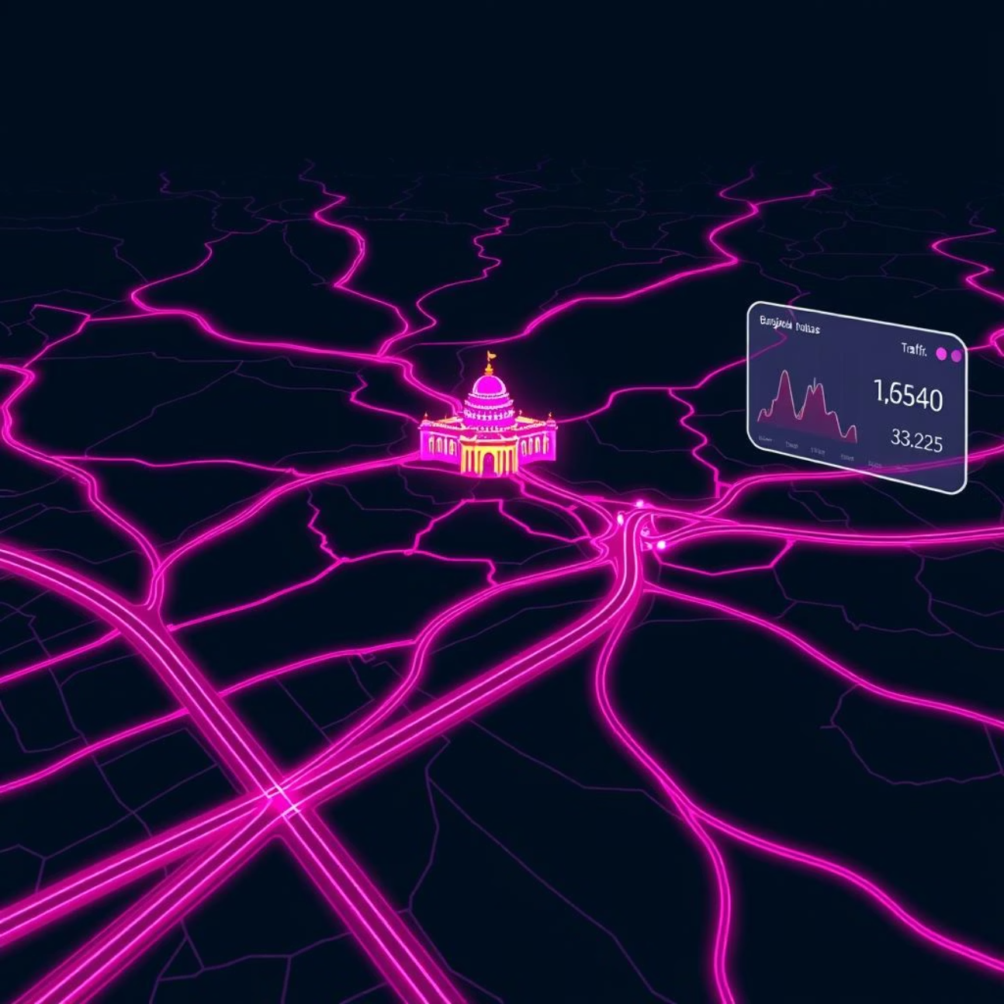
Impact on the Ground: Case Studies and Validated Performance Metrics
Pilot Project: Bengaluru City Corridor
In a 6-month pilot on a major Bengaluru arterial road, traffictelligence demonstrated a 20% reduction in average commute time during peak hours and a 15% decrease in fuel consumption for commercial vehicles.
Prediction Accuracy
75%
92%
Data Latency
30 mins
Real-time
Cost per Sq. Km.
₹50,000
₹20,000
These results showcase the tangible benefits of our solution in improving urban efficiency and sustainability.

Slide 9




Paving the Future: Scalability, Integration, and Next-Gen Enhancements
Scalable Infrastructure
Designed to expand seamlessly from a single intersection to an entire city network, handling vast data volumes.
API Integration
Easily integrates with existing smart city platforms, traffic management systems, and navigation apps via robust APIs.
Edge Computing
Future enhancements include deploying models on edge devices for faster, localised processing and reduced latency.
Autonomous Vehicle Insights
Develop deeper insights for future autonomous vehicle integration and optimising their routing.
We are continuously investing in research and development to keep traffictelligence at the forefront of traffic intelligence, ensuring adaptability to future urban mobility challenges.

Slide 10



Your Journey to Smarter Mobility: Key Takeaways and Collaboration Opportunities
Key Takeaways:
Precision: ML-driven accuracy far surpasses traditional methods.
Proactive: Predictive insights enable better planning and management.
Efficiency: Significant improvements in commute times and operational costs.
Scalable: A solution for cities of all sizes, adaptable to growth.
Let's Collaborate:
We invite urban planners, government bodies, logistics companies, and technology partners to explore how traffictelligence can transform your operations. Contact us for a detailed demonstration or a customised pilot project.

